Slide 1
Student Interests
System
Muhammad Ehtisham
BITF20M016.

Slide 2
Application Flow
1. Admin Logins
5. There is Edit form to edit
And view Page to View
Details of particular student
2. Admin Wants to add Student
3. Students that are added by admin are display in list
6. There is a
Dashboard to see the stats of
Students’ record
4. Through List Admin will edit ,view and delete the student by clicking on the options given in Actions column
7. For a particular Student to see his name in the list there is student end where he/she can check for it by searching through their emails

Slide 3
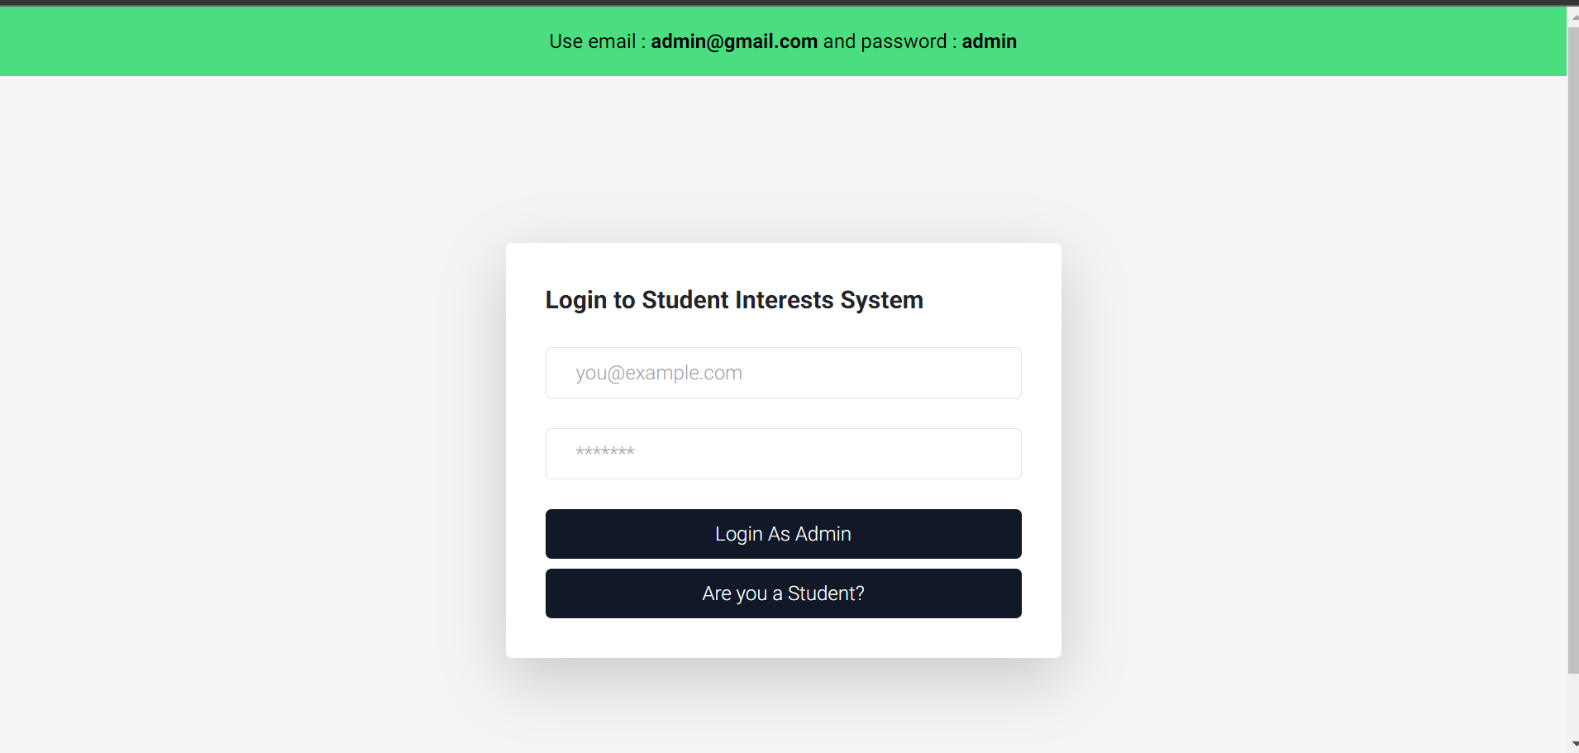

Slide 4
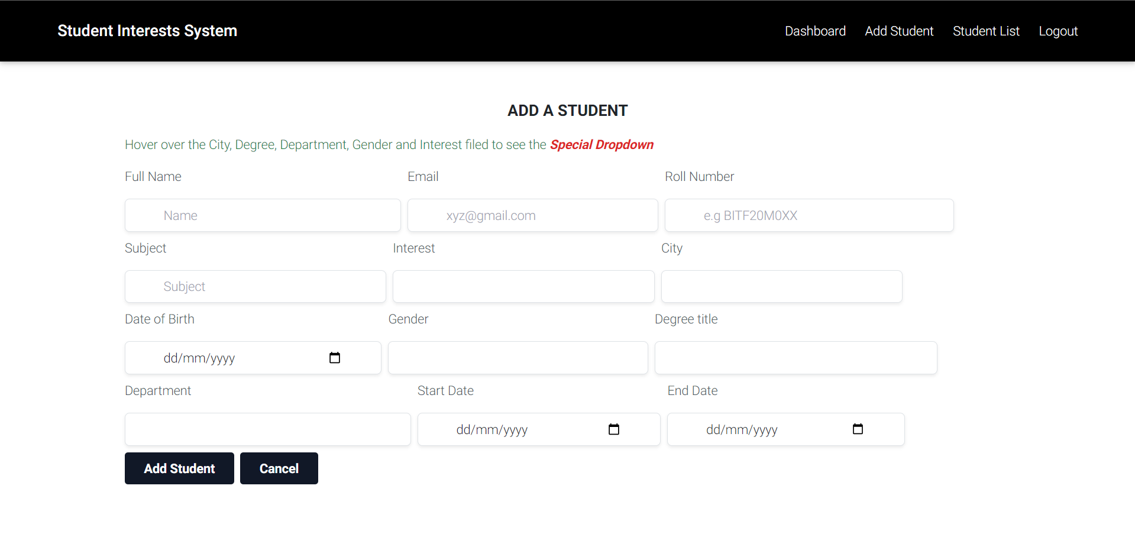

Slide 5
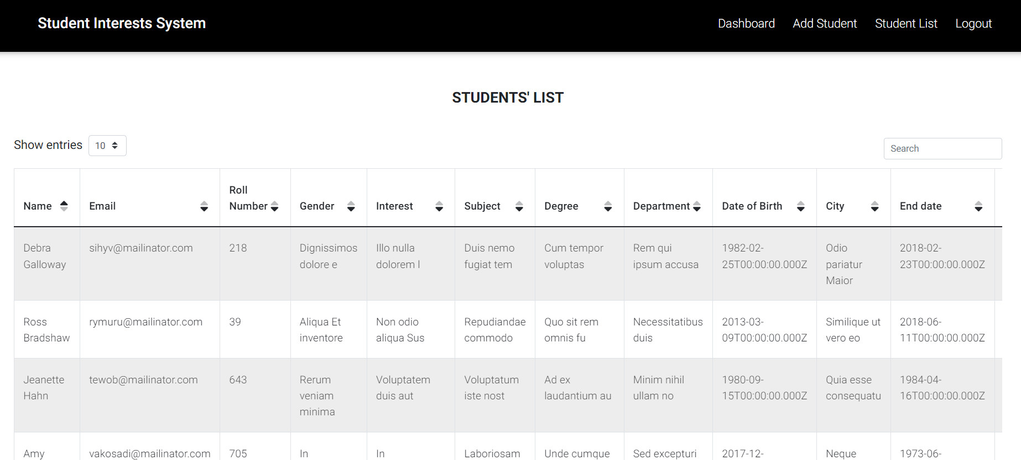

Slide 6
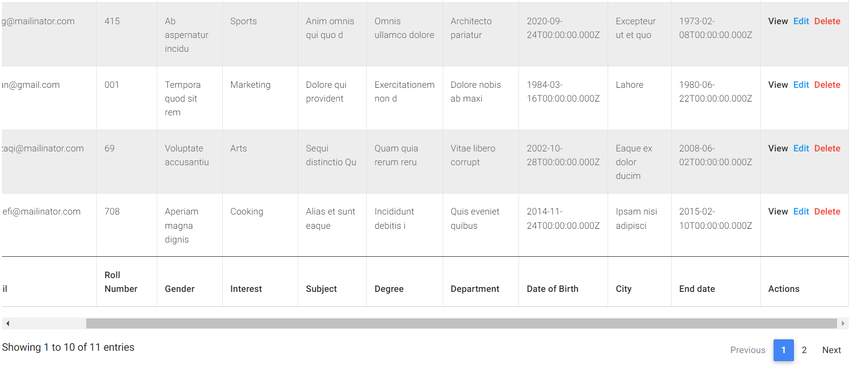

Slide 7
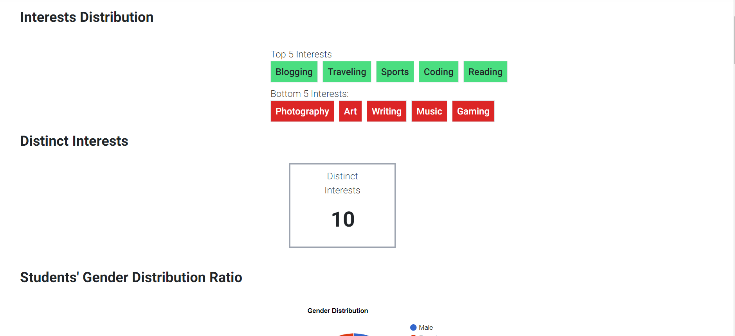
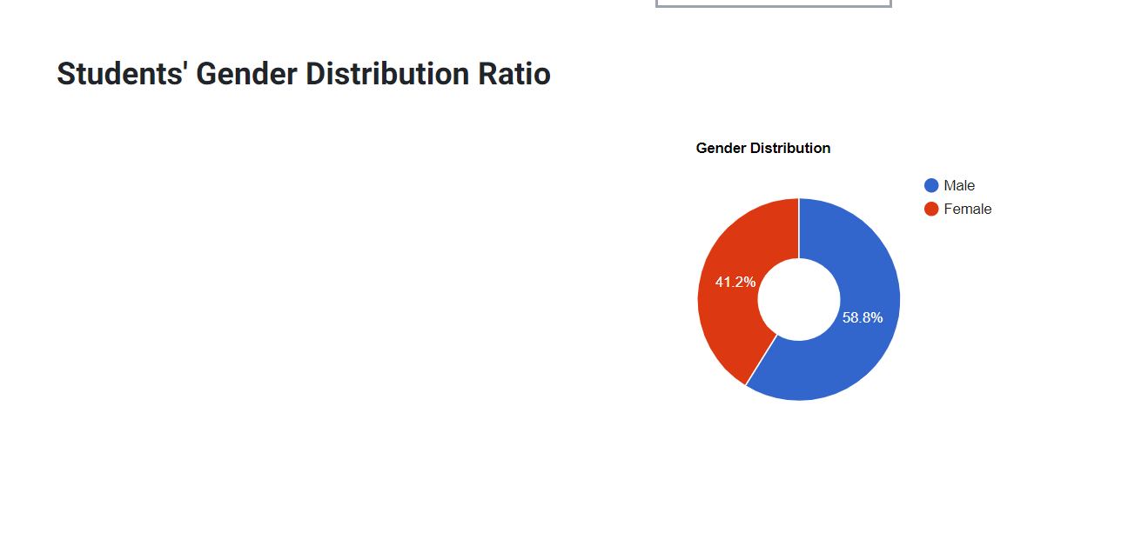
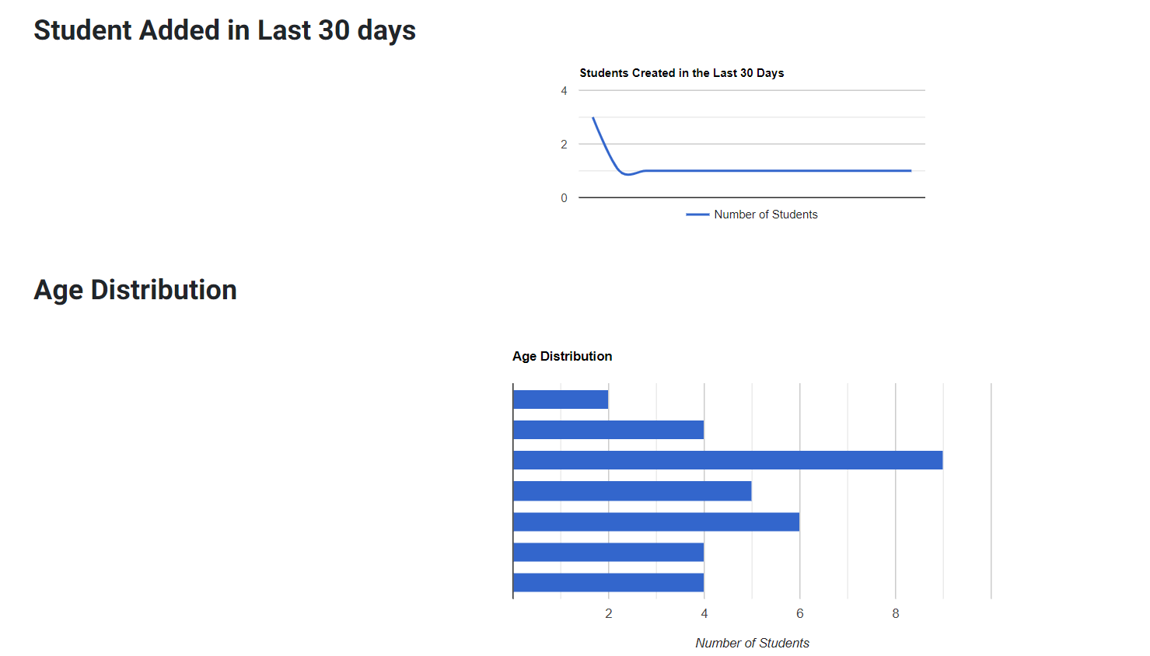
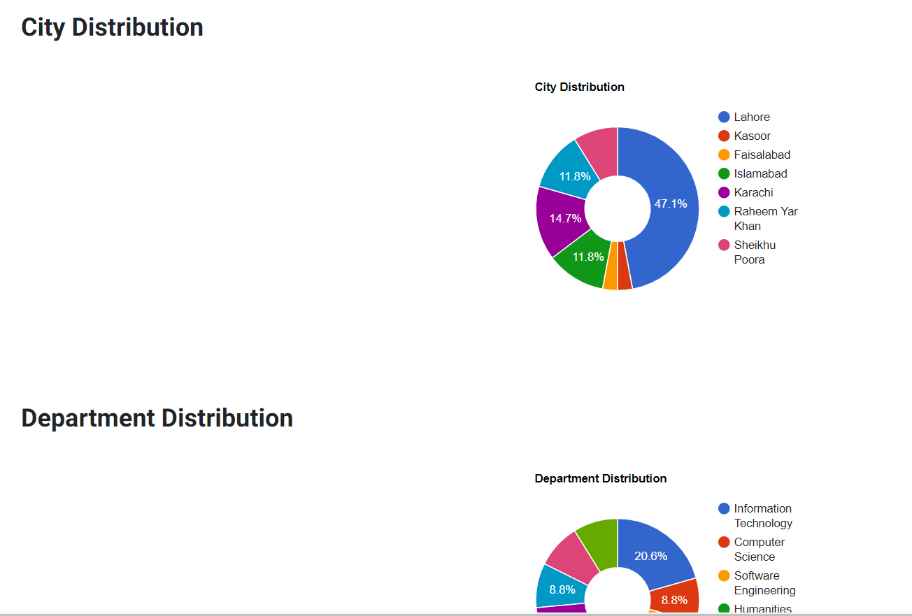
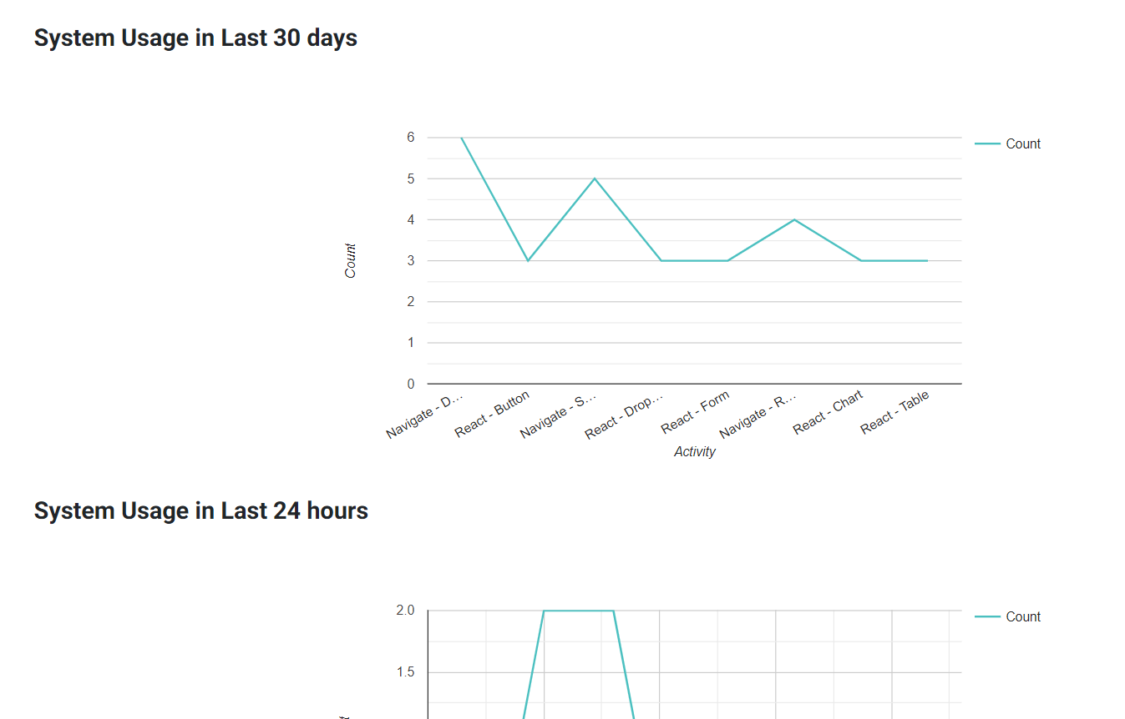

Slide 8
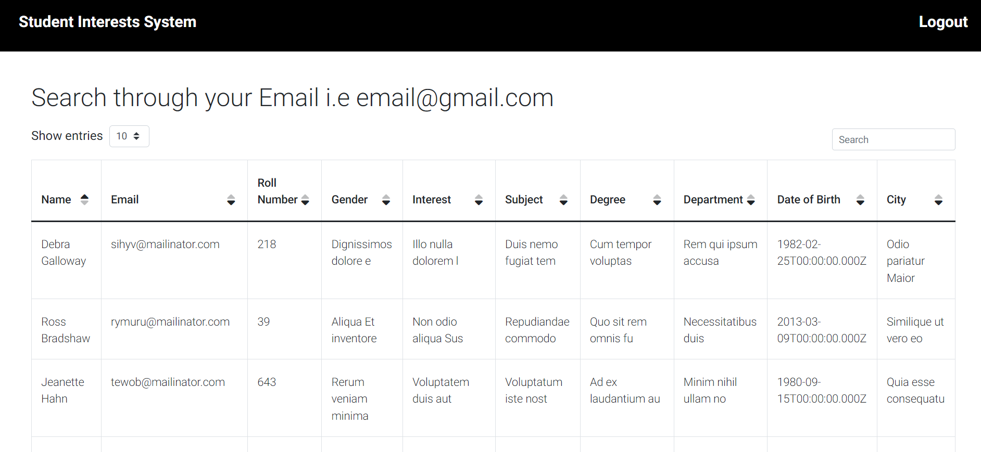

Slide 9
Technologies Used
04
Reactjs
Express.js
Javascript Framework to build user interface
Javascript framework that assist modejs
01
03
Nodejs
MongoDb
Server side javascript framework to build backend apis
Database for storing Information
02

Slide 10

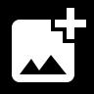

Font & Colors
Showcase how your tools work across different devices
Roboto , Sans Serif
Black and white theme
Colors are red , blue ,green are somewhere in the system
Theme is as it is according to wireframes
QUICK TIP
Try right clicking on a photo and using "Replace Image" to demonstrate your prototype.

Slide 11
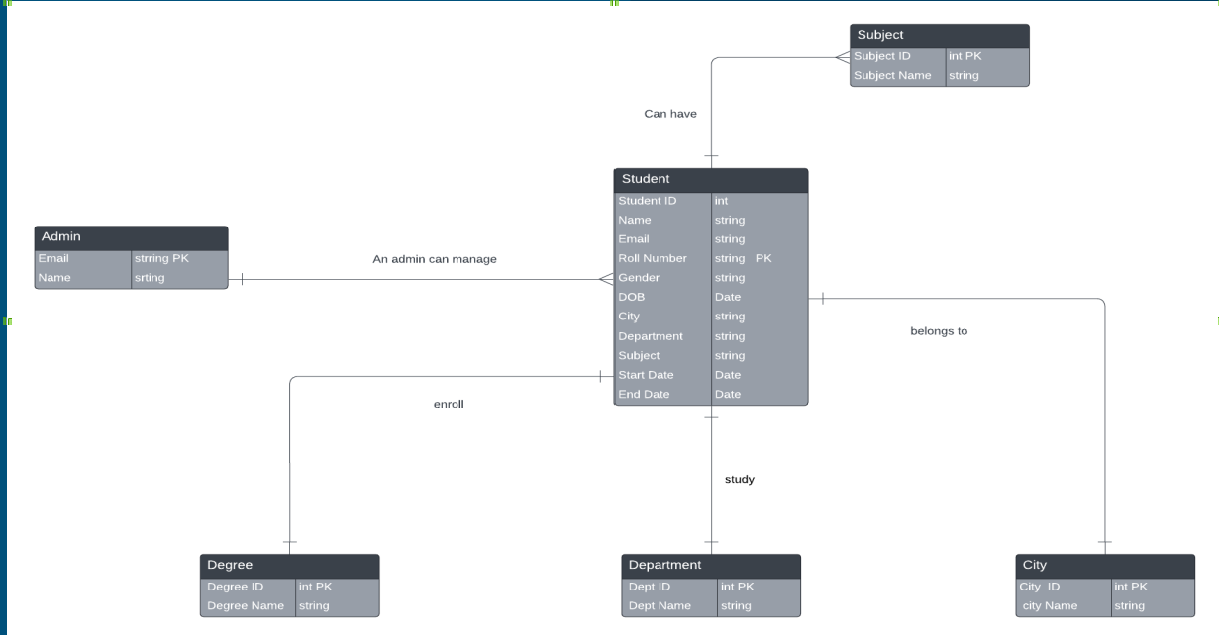

Slide 12
Thank you!

